Slide 1
CDS Evaluation
Module — Introduction

Slide 2
Outline
Clinical Decision Support
CDS Interventions
CDS Intervention Impact Evaluations

Slide 3
Module 1 Objectives
By the end of this module, you will be able to:
Identify three benefits of measuring CDS Interventions
List the five rights of CDS (Osheroff)
List three impact assessment categories of a CDS intervention
Define key terms:
Clinical Decision Support (CDS)
CDS Intervention
CDS Impact Evaluation

Slide 4
Clinical Decision Support (CDS)
Definition
Providing clinical or patient-related information, intelligently filtered and presented at appropriate times to enhance patient care.
Variety of tools to enhance decision-making:
Alerts and reminders
Clinical guidelines
Condition-specific order sets
Focused patient data reports and summaries
Documentation templates
HealthIT.gov, 2015
Notes:
This is just a small number of tools that we use to enhance our decision making abilities.

Slide 5
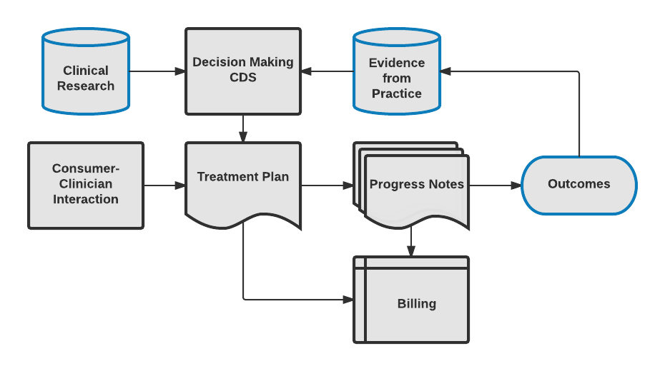
Evidence-Based CDS Interventions
Clinical Decision Support is Really Data-Driven Support
Oss, 2014
Notes:
Clinical research and evidence from practice are built into CDS tools, together with consumer-clinician interaction, treatment plans, and progress notes. This is an iterative process to continuously improve these CDS tools.

Slide 6
Technical Structures of CDS Interventions
Integrated
Stand-Alone
Push
Pull
Synchronous
Asynchronous
Hybrid
Notes:
Some of these interventions can occur independently or in combination with each other.

Slide 7
Integrated CDS Interventions
Fully functional decision support program contained within the architecture of the clinical information system (CIS)
Uses (or reuses) data collected, stored, and managed by CIS
Uses CIS functionality to communicate results of the clinical decision support system (CDSS) (via user interface)
Example: Medication/Allergy Alerting

Slide 8
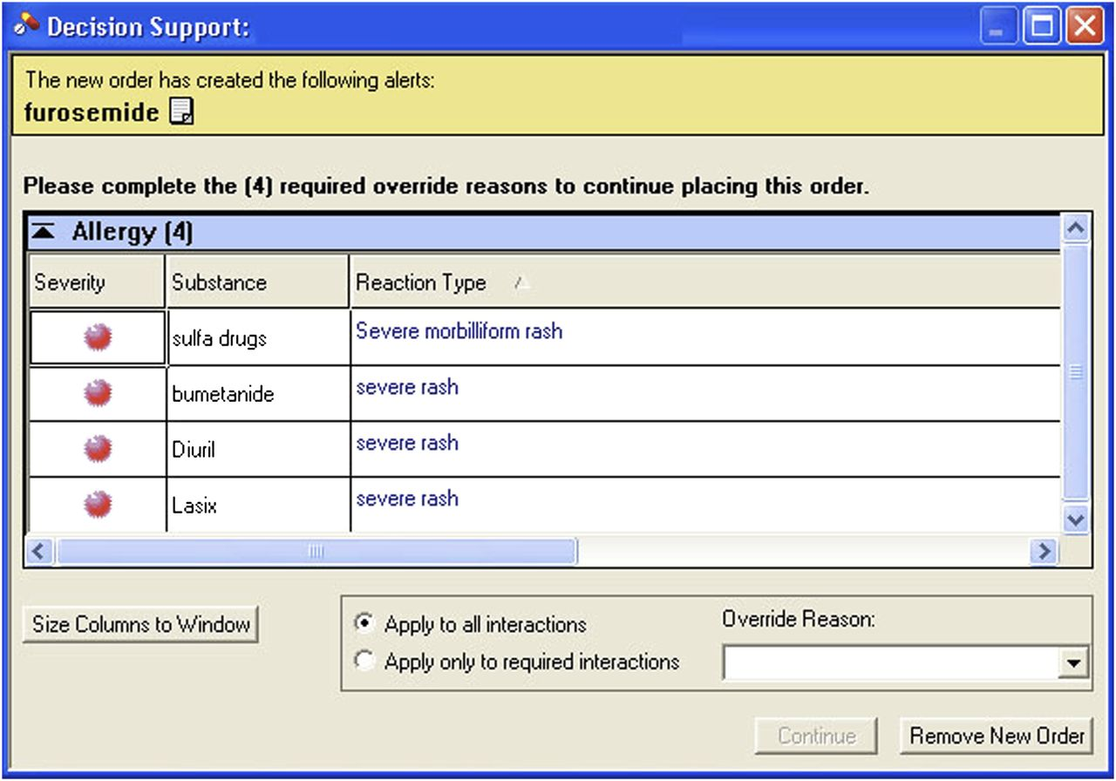
Integrated CDS
Drug Allergy Alert
Carspecken et al., 2013
Notes:
This is an example of a drug allergy alert. There are a few options for the clinician to respond to this alert. Notice that if they override the alert, they have to provide a reason for the override.

Slide 9
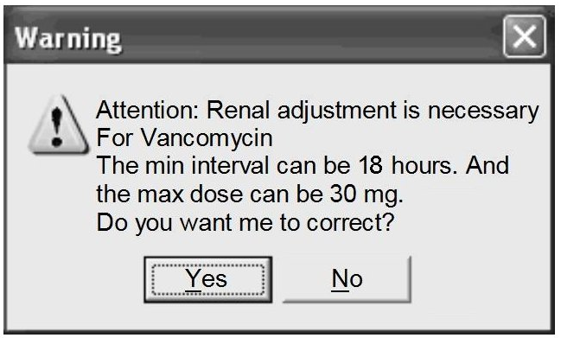
Integrated CDS
Medication Dosing Alert
Kazemi et al., 2010
Notes:
This is a very simple alert that pop-ups with the reason for the alert, and provides the clinician with a yes/no choice.

Slide 10
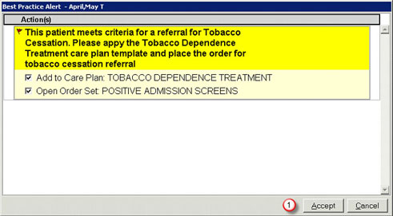
Integrated CDS
Treatment/Protocol Recommendation
University of Wisconsin Center for Tobacco Research and Intervention, n.d.
Notes:
In this case, the patient meets criteria for referral for Tobacco Cessation, and the clinician has a couple of options to add tobacco dependence treatment to care plan or open order set. Then they must accept or cancel out of the alert.

Slide 11
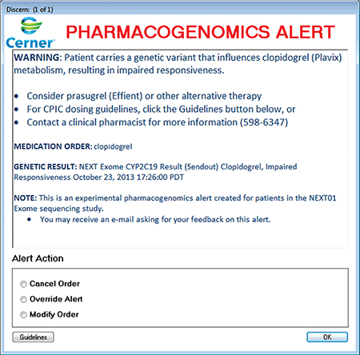
Integrated CDS
Pharmacogenomic Alert
Nishimura, A. A., et al., 2015
Notes:
This alert is saying that the patient carries a genetic variant that influences the medication being given. The clinician has the option to cancel the order, override the alert, or modify the order. There is also a button at the bottom to open up guidelines related to this alert.

Slide 12
Stand-Alone CDS Interventions
Fully functional computer program
Contains input and output functionality
Contains a knowledge base
Allows data to be entered (or contains data from any source of entry)
Runs algorithms within its system
Produces an output that supports decision making
No electronic communication to the general CIS
Example: Mobile apps (e.g., app that aids in pediatric dosing or suggests treatment based on an algorithm)
Notes:
Stand-alone CDS interventions are not tethered to the main CIS.

Slide 13
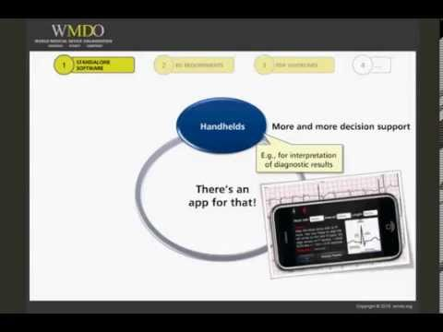
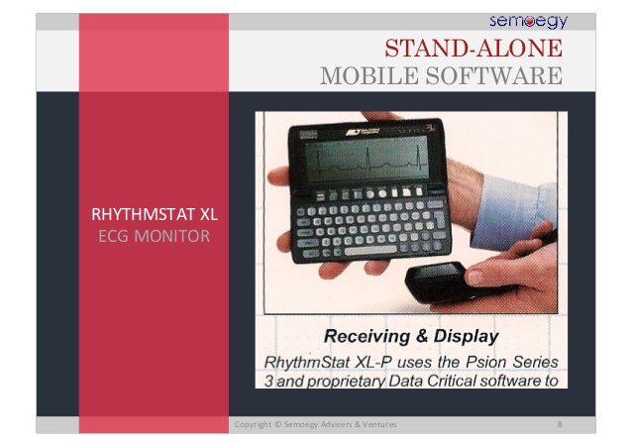
Stand-Alone CDS
WMDO, 2015
Semoegy, 2015
Notes:
Two examples of stand-alone CDS interventions.

Slide 14
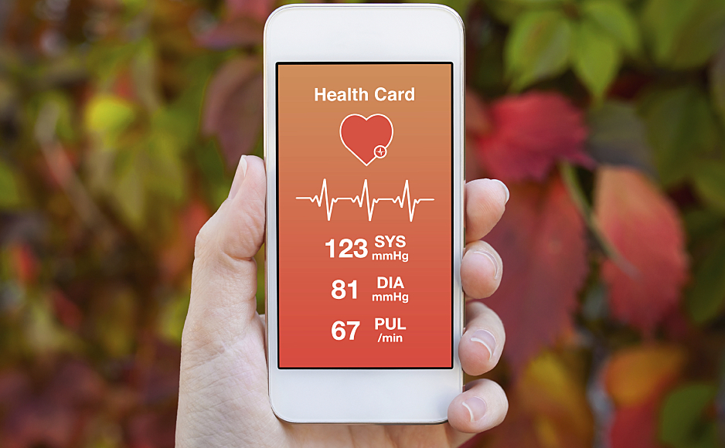
Stand-Alone CDS
Notes:
This is an image of a stand-alone CDS intervention that is a type of healthcare app accessed via a smart phone. The application is called "Health Guard," and it can capture systolic and diastolic blood pressure, pulse, and an ECG reading.

Slide 15
Integrated vs. Stand-Alone
Integrated
Information flows from beginning to end
Utilizes all pertinent data for decision making
Avoids re-entry (manual) of recorded data
More secure than Stand-Alone
Stand-Alone
Easier to set up & test
More development flexibility
May be less expensive
More difficult to be “real time”
More labor intensive to run (e.g., duplicate data entry)
Less secure than Integrated
Notes:
Integrated systems can use all of the information that is available in the CIS.
Stand-alone systems can be modified without interfering with anything related to the CIS.

Slide 16
Push CDS Interventions
Push = “server push”
A style of decision support:
Decision is initiated by the publisher or “central server”
Response is “pushed” to the clinician
The CDS intervention is “listening”
Data is entered to prompt an alert
Alert is “pushed” out to the clinician
Example: Med/Med Interaction, Med/Allergy
Notes:
The clinician doesn’t have to do anything to receive the information from the CDS intervention. The information will automatically be given to the clinician by the system.

Slide 17
Push CDS
Notes:
This alert pops-up during manual order entry when there is an issue.

Slide 18
Pull CDS Interventions
Request for support on a clinical decision
Initiated by the clinician
Clinician (or computer system) is at a specific point in decision making
Clinician seeks information (queries the database)
System provides suggestion or critique to guide decision
Example: Clinician seeks assistance from CDS for appropriate, cost-effective antibiotic medication ordering
Notes:
The clinician reaches a decision point and needs more information, so they seek out this information from a CDS intervention.

Slide 19

Pull CDS
Phillips, 2017
Notes:
In this example, the clinician is looking up guidelines for a specific medication. Since she is “requesting” additional information, this is considered a “pull” configuration for the CDS.

Slide 20
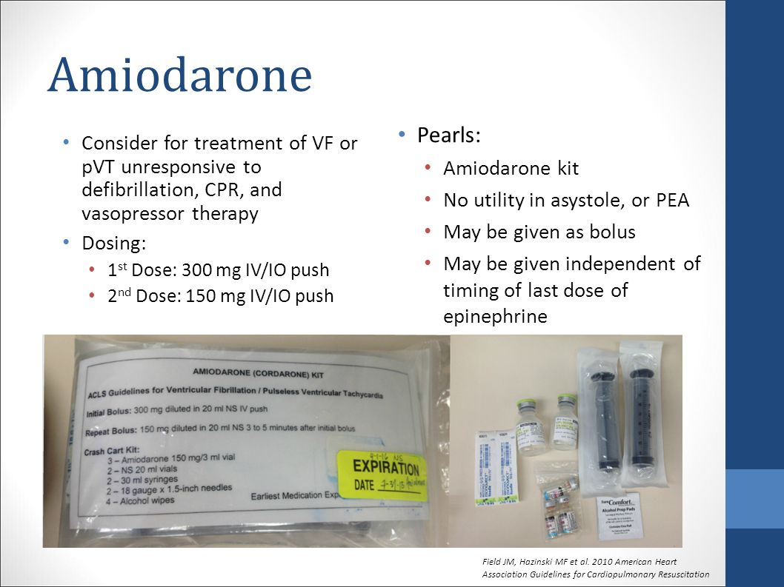
Pull CDS
Notes:
In this case, the clinician clicks on a medication and receives all of this information about the medication.

Slide 21
Push CDS Interventions
Pros
Assists in decision making
Contributes to patient safety & quality in busy, chaotic environment
Provides assistance regardless of clinician memory or state of mind
Cons
No easy way to request more input
May end up with decision support not needed or used for that patient at that time
Alert fatigue
Notes:
The clinician doesn’t have to remember to look up information since the information is automatically pushed out to them. Alert fatigue is a major concern, which will be discussed in detail later in the training.

Slide 22
Pull CDS Intervention
Pros
Assists in decision making when the clinician is seeking assistance
Only requests CDS and uses resources when needed
Cons
Clinician may not choose or remember to seek assistance
Can be disruptive to workflow if user is unfamiliar with how to seek assistance
Notes:
There could be a larger learning curve with this type of system.

Slide 23
Push vs Pull CDS Intervention
One is not better than the other
Both push and pull CDS can be highly effective in clinical settings
Selection: carefully evaluate needs
User
Specialty (clinical expertise)
System capabilities
Context of decision needs
Workflow

Slide 24
Synchronous CDS Interventions
Presented in real time
Response is presented directly on screen for clinical user
Requires clinician and CDSS to interact (communicate and respond to each other’s requests)
May forbid (block) activity until acknowledgement/reception of message (e.g., INR required to order Coumadin/warfarin)
Example: Drug dose alert, use of dose calculator or order set

Slide 25
Asynchronous CDS Intervention
Works in the background
Works without overt action from clinical user
CDSS response may be presented via asynchronous application
Email
Mobile text
Scheduling a notice for display at future login
Example: CPRS Notification System (“View Alert Screen”)
Notes:
CPRS “View Alert Screen” dose not happen in real time. It is available to you the next time you log into CPRS and engage with the system.

Slide 26
Combination CDS Interventions
Techniques are synergistic
The whole is greater than the sum of individual parts
Example: Push & Synchronous—Drug allergy alert appears when ordering a medication and patient has a documented allergy
Example: Push & Asynchronous—CPRS “View Alert Screen”
Notes:
CPRS “View Alert Screen” is being pushed at you, but it’s not happening in real time. You can view that alert the next time you log into that system.

Slide 27
Combination CDS Interventions
Example: Pull & Synchronous—Provider requests dosing assistance when ordering antibiotic therapy for an infant
Example: Pull & Asynchronous—Sending patient information and lab result data to a daily report of INR results for patients receiving anticoagulation therapy for review by clinician at later time

Slide 28
Hybrid CDS Interventions
Combination of integrated and stand-alone CDS intervention
Interface (HL7, FHIR, other...)
Has knowledge base, algorithms, decision support
Predictive analytics
Machine-learning
Cloud-based computations

Slide 29
CDS Intervention Information Sources
Almost anything—Needs to be in computable format
Coded clinical data
Collected by clinical information system (EMR)
Entered by clinician
Textual data—via Natural Language Processing (NLP)
Enterprise data warehouse/institutional resources
Health Information Exchange (coded or textual)
National guidelines
Professional standards, competencies, protocols
Evidence (literature)

Slide 30
Data for CDS Interventions
May come from multiple sources
For accurate CDS, data must always be:
Accurate
Timely
Precise
“Garbage in …Garbage out”

Slide 31
CDS Intervention

Slide 32
Definition: CDS Intervention
Specific health information technology (HIT) tools that support clinical decision making
Benefits:
Provide information at point of care
Prevent errors
Increase efficiency
Information-sharing (within and across settings)
Change provider decisions and actions
Increase preventive screenings
Increase the use of evidence-based information
Notes:
CDS interventions have several purposes. This is a truncated list of some of the benefits of CDS interventions.

Slide 33
The Five CDS Rights
What?
Who?
When?
Where?
How?
The right information
The right person
The right time
The right channels
The right formats
Notes:
Osheroff’s Five Rights Framework includes five required elements: The right information (what) is delivered to the right person (who) at the right time (when) through the right channels (where), and in the right formats (how).
Consideration to all of these can assist in CDS intervention success in completing defined goals (Osheroff, et al., 2012, p. 15).

Slide 34
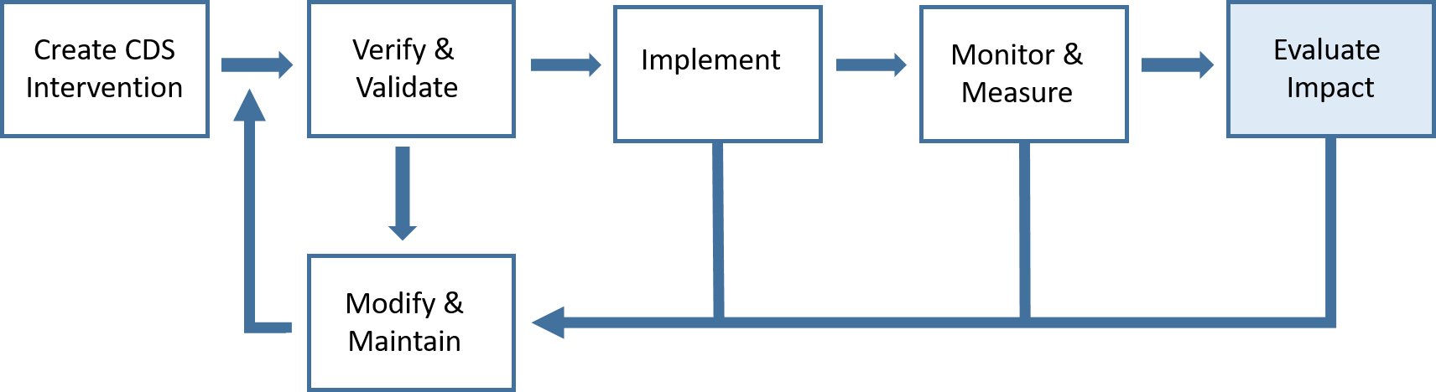
CDS Evaluation Model
General Model Figure 1. Adapted CDS Evaluation Model (Osheroff, et al., 2012, p. 92)
Notes:
The CDS evaluation model is an iterative framework with ongoing process improvement and refinement throughout. This course focuses on the highlighted blue step of the process: “Evaluate Impact.”

Slide 35
Purpose of the CDS Evaluation Model
Identify unintended consequences of CDS interventions
Manage CDS interventions and their components
Track development of CDS intervention
Improve efficiency of CDS development
Iteratively improve quality of CDS interventions

Slide 36
CDS Intervention Impact Evaluation

Slide 37
Operational Definition: CDS Impact
The measurable change(s) in the quality (i.e., effectiveness, safety, efficiency, and satisfaction) of health care generated by the introduction of CDS interventions
Includes:
Osheroff’s five rights
Usability (effectiveness, safety, efficiency, satisfaction)
Outcomes
Can be measured anywhere in healthcare process

Slide 38
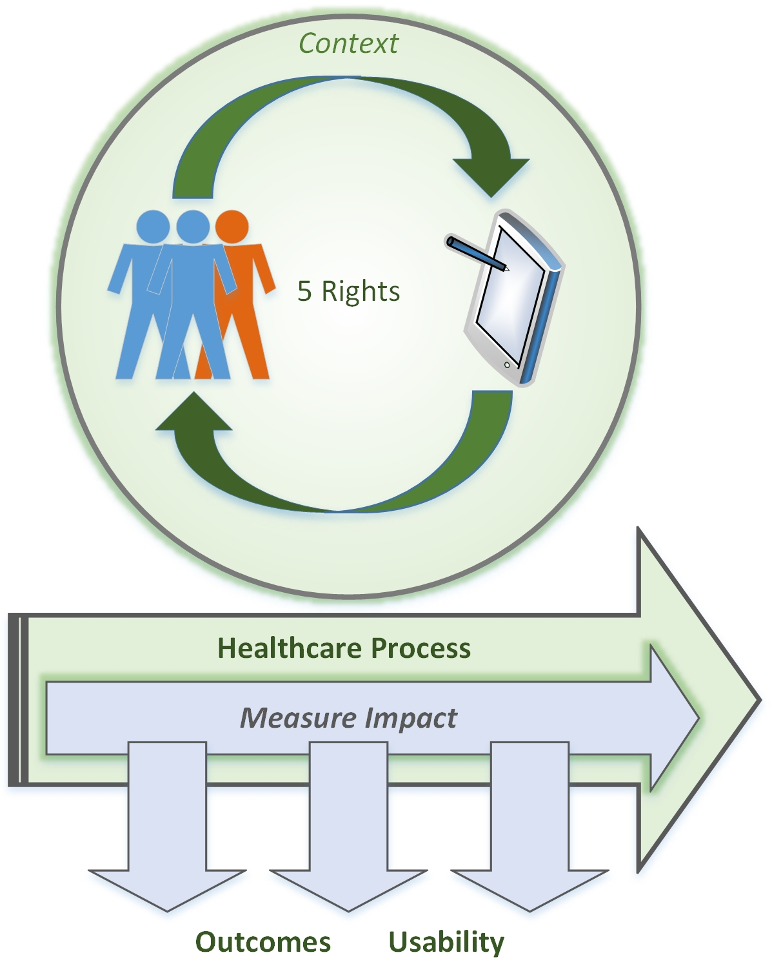
CDS Impact Evaluation
Notes:
The range of outcomes from the implementation and use (or lack of use) of CDS interventions
Can be intended (e.g., reduced medication errors) or unintended (e.g., new errors due to the design of the CDS user interface)
Consistent with Institute of Medicine (IOM) categories of effectiveness, safety, efficiency, and satisfaction

Slide 39
CDS Evaluation Process Model
Prepare
Model Work Context
Workflow
Sketch workflows
Plan
Set evaluation objectives
Heuristic Evaluation
Walkthrough
Formative Evaluation
Integrate Results
Rank findings
Report findings
Create usage scenarios
Create evaluation plan
Gather information
Inspect user interface
Observe scenario use (think aloud)
Observe scenario use (passive)

Slide 40
Assessment vs Evaluation
Assessment: A specific technique or interim measure
Evaluation: A collection of assessment techniques to determine:
Impact of CDS interventions
Value
Outcomes

Slide 41
Measuring CDS Intervention Impact
Assure CDS interventions improve care
Determine whether CDS interventions are working as expected
Provide continual evaluation via user feedback
Determine CDS cost effectiveness
Justify CDS interventions
Communicate CDS impact & effectiveness
Create new knowledge
Create implementation best practices

Slide 42
Impact Assessment Categories
Effective
Efficient
Safe
Satisfactory
Right person to receive the intervention
Right information presented to end user
Right time in the workflow
Right channel (device) for delivery
Right intervention format (interaction)
Usability CDS Impact Examples
Effectiveness (fit with workflow, info available for decisions)
Efficiency (interaction time)
Patient safety (accuracy/errors, risk)
Subjective satisfaction
Can include benchmarks
Outcome Examples
Effectiveness (reduced errors, right treatments at the right time for the right patients, improved throughput)
Efficiency (scheduling, appointment time, )
CDS intervention satisfaction across providers
Notes:
The five rights framework is useful to examine CDS interventions after the interventions are fielded. As evaluators concentrate on this phase of the CDS life cycle, keep in mind the five rights do not directly address critical aspects of CDS, like the user interface. It is implied across the five rights (e.g., in the right information category), but no specific category focuses on the various dimensions of the user interface. Therefore, we added specific usability categories to the model. Evaluators may want to explicitly examine the user interface as part of their goals, in the “format” categories, for example. Evaluators may then want to employ usability methods and make one of their CDS goals specifically about examining the user interface in depth.

Slide 43
Specific Impact Assessment Categories
Measure | Effectiveness | Safety | Efficiency | Satisfaction
Right Information Presented to End User | Clinical Information | Information Safety | Clinical Information Efficiency | CDS Satisfaction Score
Right Person to Receive Intervention | Recipient Accuracy | Recipient Accuracy | Recipient Efficiency
Right Time in the Workflow | Workflow Effectiveness | Workflow Safety | Workflow Efficiency
Right Channel (Device) for Delivery | Delivery Channel Effectiveness | Delivery Channel Safety | Delivery Channel Efficiency
Right Intervention Format (Interaction) | Intervention Type & Format | Intervention Format Safety | Intervention Format Efficiency
Patient (Individual or Population) Outcomes | Efficacy | Patient Safety Accuracy | Patient-Level Efficiency
Process or Organizational Outcomes (Avoided or Incurred) | Process/Org Effectiveness Cost | Process/Org Safety Cost | Process/Org Efficiency Cost
Notes:
Columns:
Measure: The Five Rights plus outcomes (Patient, Process or Organizational)
Effectiveness: CDS intervention is based on scientific knowledge & performs its designed task effectively
Safety: CDS intervention avoids harm to patients & performs its designed task safely
Efficiency: CDS intervention avoids waste & performs its designed task efficiently
Satisfaction: CDS intervention improves end user satisfaction

Slide 44
Recap
CDS Intervention
Benefits
Five rights
CDS Impact
Assessment & Evaluation
Specific Impact Assessment Categories
Effective
Safe
Efficient
Satisfactory
Individual outcomes
Organizational outcomes

Slide 45
Module 1 Review
Identify three benefits of measuring CDS Interventions
List the five rights of CDS (Osheroff)
List three impact assessment categories of a CDS intervention
Define key terms:
Clinical Decision Support (CDS)
CDS Intervention
CDS Impact Evaluation
Notes:
Why is this material important? This will serve as the foundation for all the later modules.

